Slide 1
Introduction to Preferential Ridings Proportional with Second- choice Vote Electoral System - PRP2 developed with the feedback of many interested Yukoners
New point-based vote-counting system
Prepared for presentation to Yukon Citizens Assembly on Electoral Reform

Slide 2
Overall Goals of System
Second-choice votes make it possible for all voters to be able to discuss their concerns with an MLA that their vote elected, leading to more democratic engagement of constituents.
Simple system to vote and implement
Ballot allows voters more choice of candidates plus party to be governed by
Paired-ridings avoid additional seats: one riding seat plus one proportional seat. Eg. Riverdale North and Riverdale South become one Riverdale riding seat plus one proportional seat for Whitehorse.

Slide 3
Paired Ridings Grouped Into Electoral Areas
Each Riding has one Geographical MLA elected from preferential ballot using points from first and second choices on ballots.
Point System described later
Ridings grouped into 3 electoral areas or regions for proportional MLAs:
Whitehorse (10 MLAs)
Yukon West and North (5 MLAs)
Yukon South Centre and East (4 MLAs)
MLAs for Proportional Party Seats are elected based on highest percentage of points in their riding (but did not win the riding seat).

Slide 4
Whitehorse Electoral Area
5 Paired Riding Seats PLUS 5 Proportional Seats
Riverdale South and Riverdale North
Copperbelt North and Whitehorse West
Porter Creek North and Porter Creek Centre
Porter Creek South and Takhini – Copper King
Whitehorse Centre and Mountain View

Slide 5
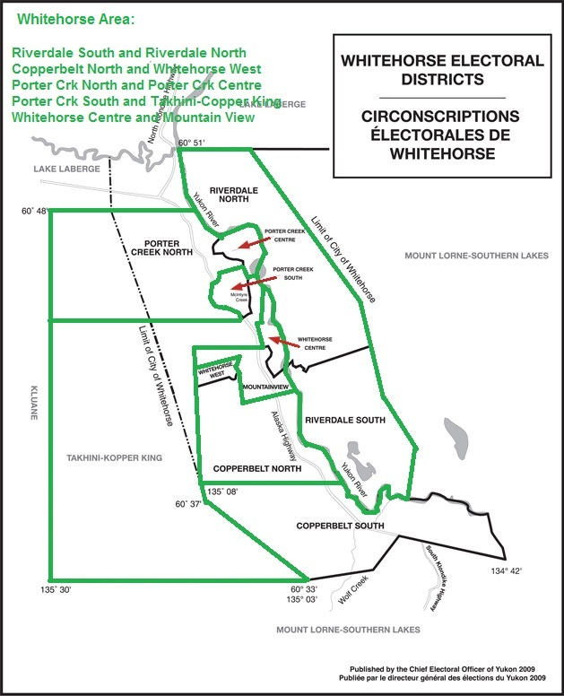

Slide 6
South Centre and East Yukon Electoral Area
2 Paired Riding Seats PLUS 2 Proportional Seats
Mount Lorne – Southern Lakes and Copperbelt South
Pelly – Nisutlin and Watson Lake

Slide 7
West and North Yukon Area
2 Paired Riding Seats PLUS 2 Proportional Seats PLUS Vuntut Gwitchin as an Individual Riding
Kluane and Lake Laberge
Klondike and Mayo-Tatchun
Party Votes from Vuntut Gwitchin for Proportional Seats of this Area
Non-winning Old Crow candidates are not eligible as a Proportional Candidate

Slide 9
Point System to Elect Paired-riding MLAs
2 Examples:
5 Candidates Running in a Riding
First Choice Vote provides 4 Points
Second Choice Vote provides 3 Points
8 Candidates Running in a Riding
First Choice Vote provides 7 Points
Second Choice Vote provides 6 Points
Candidate with the highest number of points in each riding is elected
Candidate with lowest number of First-choice votes can win the seat from second choice vote points NOTE: Effectiveness of MLAs elected by FPTP, and overall governance, are greatly affected by the voters who did not vote for the MLA. Whether second-choice or last-choice has an effect.

Slide 10
Election of Proportional Candidates
Overall Party Preference Based on Percentage of Party Points totaled within each of the 3 Geographic areas
Each Party’s Proportional Seats are awarded to the Party’s Candidates that were not elected as a Riding MLA with the highest Percentage of Paired-riding Points

Slide 11
Preferential Ridings Proportional with second-choice vote PRP2 system

Slide 12
Effect of Boundaries Commission on PRP2 The PRP2 system will function effectively with boundary changes. The maximum size of electoral areas is ten MLAs. If there are more than ten MLAs in a region, two electoral areas will be formed. In past FPTP elections, using present boundaries, the new system without second-choice votes, has taken vote representation in elections from less than 50% to more than 90%. Second-choice votes make 100% vote representation possible.

