Slide 1
Introduction to Preferential Ridings Proportional with Second- choice Vote Electoral System - PRP2 developed with the feedback of many interested Yukoners and others
New point-based vote-counting system
Prepared for presentation to Yukon Citizens Assembly on Electoral Reform

Slide 2
Overall Goals of System
Second-choice votes make it possible for all voters to be able to discuss their concerns with an MLA that their vote elected, leading to more democratic engagement of constituents.
Simple system to vote and implement
Ballot allows voters more choice of candidates plus party to be governed by
Paired-ridings avoid additional seats: one riding seat plus one proportional seat.
Eg. Riverdale North and Riverdale South become one Riverdale riding seat plus one proportional seat for Whitehorse.
Little chance of counting errors. Only one count is required.

Slide 3
Paired Ridings Grouped Into Electoral Areas
Each Riding has one Geographical MLA elected from preferential ballot using points from first and second choices on ballots.
  Point System described later
Ridings grouped into 3 electoral areas or regions for proportional MLAs:
  Whitehorse (10 MLAs)
  Yukon West and North (5 MLAs)
  Yukon South Centre and East (4 MLAs)
MLAs for Proportional Party Seats are elected based on highest percentage of points in their riding (but did not win the riding seat).

Slide 4
Whitehorse Electoral Area
5 Paired Riding Seats PLUS 5 Proportional Seats
  Riverdale South and Riverdale North
  Copperbelt North and Whitehorse West
  Porter Creek North and Porter Creek Centre
  Porter Creek South and Takhini – Copper King
  Whitehorse Centre and Mountain View

Slide 5
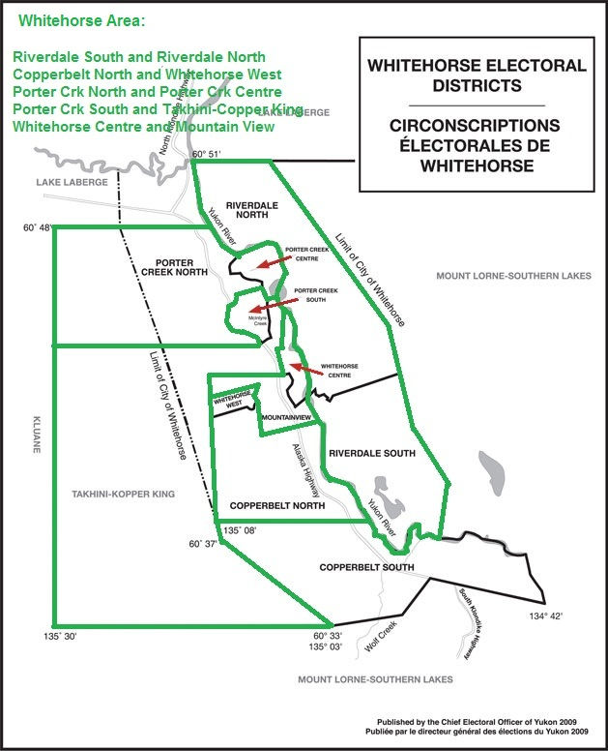

Slide 6
South Centre and East Yukon Electoral Area
2 Paired Riding Seats PLUS 2 Proportional Seats
  Mount Lorne – Southern Lakes and Copperbelt South
  Pelly – Nisutlin and Watson Lake

Slide 7
West and North Yukon Area
2 Paired Riding Seats PLUS 2 Proportional Seats PLUS Vuntut Gwitchin as an Individual Riding
  Kluane and Lake Laberge
  Klondike and Mayo-Tatchun
  Party Votes from Vuntut Gwitchin for Proportional Seats of this Area
  Non-winning Old Crow candidates are not eligible as Proportional Candidates

Slide 8
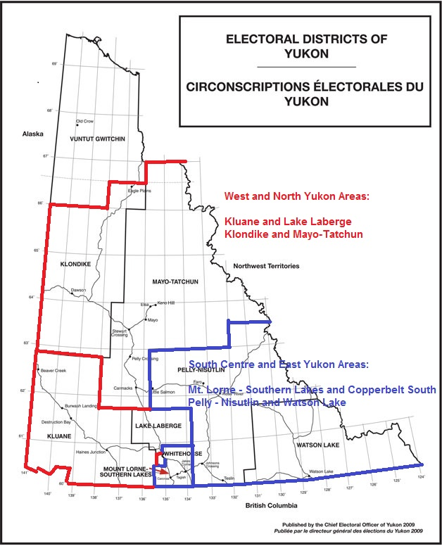

Slide 9
Point System to Elect Paired-riding MLAs
2 Examples:
  5 Candidates Running in a Riding
    First Choice Vote provides 4 Points
    Second Choice Vote provides 3 Points
  8 Candidates Running in a Riding
    First Choice Vote provides 7 Points
    Second Choice Vote provides 6 Points
Candidate with the highest number of points in each riding is elected
  Candidate with lowest number of First-choice votes can win the seat from second choice vote points. In party leadership campaigns which are knock-out preferential, I have heard it said, “The first candidate knocked out with the least First-choice votes would have been the best leader, because that candidate was connected to the most voters, but not their first-choice.” Have you ever heard or personally thought that?

Slide 10
Election of Proportional Candidates
Political parties win proportional seats when they need seats to reach their popular vote in each electoral area or region.
Each Party’s Proportional Seats are awarded to the party’s Candidates that were not elected as a Riding MLA with the highest Percentage of points in their riding.

Slide 11
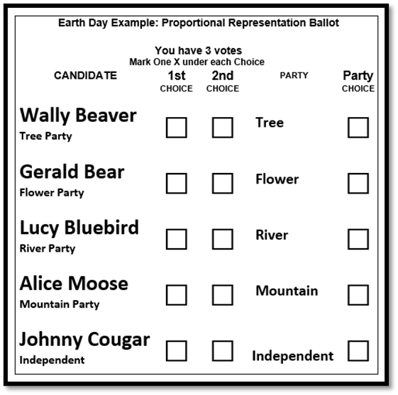
Preferential Ridings Proportional with second-choice vote PRP2 system
With our present FPTP system, each voter has one choice. The voter makes that choice on the value placed on three or more factors: 1. the candidate for whom the voter most wants to vote, 2. the okay candidate who has a good chance of winning (strategic), or 3. the party of the voter’s choice. Sometimes one candidate fits all three choices, but far from always.
With PRP2, voters have three separate choices, so they do not have to choose between what they value most. Voters can satisfy all three of their value choices.
How often do voters not vote for their favorite candidate because it would be a wasted vote? With PRP2, proportional seats can be won by those valuable candidates not expected to win.

Slide 12
Effect of Boundaries Commission on PRP2
The PRP2 system will function effectively with boundary changes.
The maximum size of electoral areas is ten MLAs. If there are more than ten MLAs in a region, two electoral areas will be formed.
In past FPTP elections, using present boundaries, the new system without second-choice votes, has taken vote representation in elections from less than 50% to more than 90%. Second-choice votes make 100% vote representation possible. COMMUNITY-BUILDING INCLUSION

